Slide 1

AIMA Code: Search Algorithms
CSE–391: Artificial Intelligence
University of Pennsylvania
Matt Huenerfauth
February 2005

Slide 2
Overview of Today's Class
Look at Some Search Code from Textbook
  Important Utilities in the Code
  Problem and Node Classes
  Uninformed Search: BFS, DFS, (DLS), (IDS)
  Informed Search: Best–First, Greedy, A*
  Some thoughts on Heuristics

Slide 3

The Problem Class
and
The Node Class

Slide 4
Class Problem
To build a new problem to be solved using these AI search
algorithms, you make a subclass of this generic Problem class:
class Problem:
def __init__(self, initial, goal=None): # Constructor: Initial? Goal?
self.initial = initial;
self.goal = goal .
def successor(self, state): # Returns list of successors of a state.
abstract()
def goal_test(self, state): # Helps us decide if some state is a goal.
return state == self.goal # Could be a fancier calculation here.
def path_cost(self, c, state1, action, state2): # Cost from initial to here.
return c + 1
def value(self): # Used for hill-climbing problems.
abstract()
I erased the doc strings from this code to fit it on one slide…

Slide 5
abstract() – see utils.py
abstract()
  Returns error message if called.
  So, what’s the point of it?
    Put this inside a method of a parent class
    that you want the user to inherit from.
    Forces user to redefine the method
    containing abstract() before calling it
    to avoid getting the error.

Slide 6
Class Problem (2)
class Problem:
. . .
def successor(self, state): # Returns list of successors of a state.
"""Given a state, return a sequence of (action,
state) pairs reachable from this state."""
abstract() # You have to redefine this method.
The list returned should contain (action, state) pairs:
  The action would be one of the operations that is possible in this problem. It would be some kind of string or symbol to represent the action. e.g. Missionary & Cannibals: -101
  The state is the new state you reach when performing this operation. e.g. Missionary & Cannibals: 230

Slide 7
Class Problem (3)
c = 34
state1
class Problem:
. . .
def path_cost(self, c, state1, action, state2):
"""Return the cost of a solution path that arrives at state2
from state1 via action, assuming cost c to get up to state1.
If the problem is such that the path doesn't matter, this
function will only look at state2. If the path does matter,
it may consider c and maybe state1 and action."""
return c + 1 # For now, assume each step costs 1.
action
state2

Slide 8
States vs. Nodes
Remember the difference between “states” in
an AI problem and “nodes” in a search tree?
  An AI problem, when formally defined, models the state of the world by using some variables, numbers, and symbols.
    331 : Missionaries and Cannibals
    [ [ _ , _ , X ] , [ _ , O , _ ] , [ _ , _ , _ ] ] : Tic Tac Toe
  A “State” is one possible way to set the variables.

Slide 9
States vs. Nodes
Remember the difference between “states” in
an AI problem and “nodes” in a search tree?
  A Node is a data structure that is part of a search tree.
  You build nodes while you perform your search, and you can associate them with particular states of your AI problem that each is representing.
  If you get to the same state by way of two different paths in a search tree, then you might have 2 nodes that represent to the same state (i.e. they have the same setting of the variables). That’s not a disaster…

Slide 10
Class Node
class Node:
…
def __init__(self, state, parent=None, action=None, path_cost=0):
…
def __repr__(self):
…
def path(self):
…
def expand(self, problem):
…

Slide 11
update() – see utils.py
update(x, a=1, b=2, c=3) – Set dictionary/object info.
  An alternate syntax for setting the key/value pairs in a dictionary or setting the attributes of an object.
  If x is dictionary: x={'a':1, 'b':2, 'c':3}
  If x is object: x.a=1
  x.b=2
  x.c=3

Slide 12
Class Node
Node:
State
Parent
Action
Path_Cost
Depth
class Node:
def __init__(self, state, parent=None, action=None, path_cost=0):
"Create a search tree Node, derived from a parent by an action."
update(self, state=state, parent=parent, action=action,
path_cost=path_cost, depth=0) # set all these attributes
if parent: # roots don't have parents
self.depth = parent.depth + 1 # calculate my depth if not root.
def __repr__(self):
“Print this node.”
return "<Node %s>" % (self.state,) # If state were a tuple, could mess
# up print command. This is safe.
…

Slide 13
Class Node
class Node:
…
def path(self):
"Create a list of nodes from the root to this node.“
x, result = self, [self] # result is a list of nodes, starting with me
while x.parent: # index x traces backwards to root
result.append(x.parent) # add nodes we visit to end of list
x = x.parent # take a step up using parent pointer
return result
def expand(self, problem):
"Return a list of nodes reachable from this node."
return [Node(next, self, act,
problem.path_cost(self.path_cost, self.state, act, next))
for (act, next) in problem.successor(self.state)]
For each successor (action, state) that we can reach from me:
Build a new node whose parent is me, whose action to get there is
action, whose state is state, and whose cost we now calculate.

Slide 14

The Uninformed
Search Algorithms

Slide 15
Stacks, Queues, Heaps – see utils.py
We'll see these objects used by various search algorithms...
Three data structures are defined in the code.
Stack(): A Last-In-First-Out list data structure.
FIFOQueue(): A First-In-First-Out list data structure.
PriorityQueue(func): List of items sorted by ‘func’, (default <).
Each type supports the following methods and functions:
q.append(item) -- add an item to the list (in right place)
q.extend(items) -- equivalent to: for item in items:
q.append(item)
q.pop() -- return the “next” item from the list,
and remove it from the list
len(q) -- number of items in q

Slide 16
Tree-Style Searching
def tree_search(problem, succlist): # succlist is a stack or queue
succlist.append(Node(problem.initial)) # Add root to list.
while succlist: # Still succlist to explore?
node = succlist.pop() # Grab node on succlist.
if problem.goal_test(node.state): # Return node if the goal.
return node
succlist.extend(node.expand(problem)) # Add children to succlist.
return None
def breadth_first_tree_search(problem):
return tree_search(problem, FIFOQueue()) # Use a QUEUE!!!
def depth_first_tree_search(problem):
return tree_search(problem, Stack()) # Use a STACK!!!

Slide 17
Why Queue vs. Stack?
The only difference between the breadth first and depth first algorithms we discussed in class was where they put newly found nodes on the successor list:
  Breadth first: At the back. (Queue.)
  Depth first: At the front. (Stack.)
So, we only have to write this searching code once, and then the user passes the proper data structure in as a parameter to __init__().

Slide 18
Tree-Style Searching
def tree_search(problem, succlist): # succlist is a stack or queue
succlist.append(Node(problem.initial)) # Add root to list.
while succlist: # Still succlist to explore?
node = succlist.pop() # Grab node on succlist.
if problem.goal_test(node.state): # Return node if the goal.
return node
succlist.extend(node.expand(problem)) # Add children to succlist.
return None
def breadth_first_tree_search(problem):
return tree_search(problem, FIFOQueue()) # Use a QUEUE!!!
def depth_first_tree_search(problem):
return tree_search(problem, Stack()) # Use a STACK!!!

Slide 19
Tree vs. Graph Search
Tree search might find a state by another path through the search tree, and it wouldn't know it already explored it.
  It would then add all the node’s children to the succlist twice!
  The state space of some problems is tree-like in shape, and for these problems where there is only one path to any state, then a tree search is just fine. But this is not the case in general.
Graph search is smarter: it remembers all the states it has
‘expanded’ before no matter what path it took to get there.
  It doesn't waste time or space by adding the children of a node to the succlist twice.

Slide 20
Tree-Style Searching
def tree_search(problem, succlist): # succlist is a stack or queue
succlist.append(Node(problem.initial)) # Add root to list.
while succlist: # Still succlist to explore?
node = succlist.pop() # Grab node on succlist.
if problem.goal_test(node.state): # Return node if the goal.
return node
succlist.extend(node.expand(problem)) # Add children to succlist.
return None
def breadth_first_tree_search(problem):
return tree_search(problem, FIFOQueue()) # Use a QUEUE!!!
def depth_first_tree_search(problem):
return tree_search(problem, Stack()) # Use a STACK!!!

Slide 21
Tree-Style Searching
def tree_search(problem, succlist): # succlist is a stack or queue
succlist.append(Node(problem.initial)) # Add root to list.
while succlist: # Still succlist to explore?
node = succlist.pop() # Grab node on succlist.
if problem.goal_test(node.state): # Return node if the goal.
return node
succlist.extend(node.expand(problem)) # Add nodes to the succlist.
return None
def breadth_first_tree_search(problem):
return tree_search(problem, FIFOQueue()) # Use a QUEUE!!!
def depth_first_tree_search(problem):
return tree_search(problem, Stack()) # Use a STACK!!!

Slide 22
Graph-Style Searching
def graph_search(problem, succlist):
closed = {} # Keep a list of whom you see.
succlist.append(Node(problem.initial))
while succlist:
node = succlist.pop()
if problem.goal_test(node.state):
return node
if node.state not in closed: # Didn't expand this STATE before?
closed[node.state] = True # Add to the 'checked' list.
succlist.extend(node.expand(problem))
return None
def breadth_first_graph_search(problem):
return graph_search(problem, FIFOQueue())
def depth_first_graph_search(problem):
return graph_search(problem, Stack())

Slide 23
Graph-Style Searching
def graph_search(problem, succlist):
closed = {} # Keep a list of whom you see.
succlist.append(Node(problem.initial))
while succlist:
node = succlist.pop()
if problem.goal_test(node.state):
return node
if node.state not in closed: # Didn't expand this STATE before?
closed[node.state] = True # Add to the 'checked' list.
succlist.extend(node.expand(problem))
return None
def breadth_first_graph_search(problem):
return graph_search(problem, FIFOQueue())
def depth_first_graph_search(problem):
return graph_search(problem, Stack())

Slide 24
The Uninformed
Depth-Limited
and Iterative
Search Algorithms

Slide 25
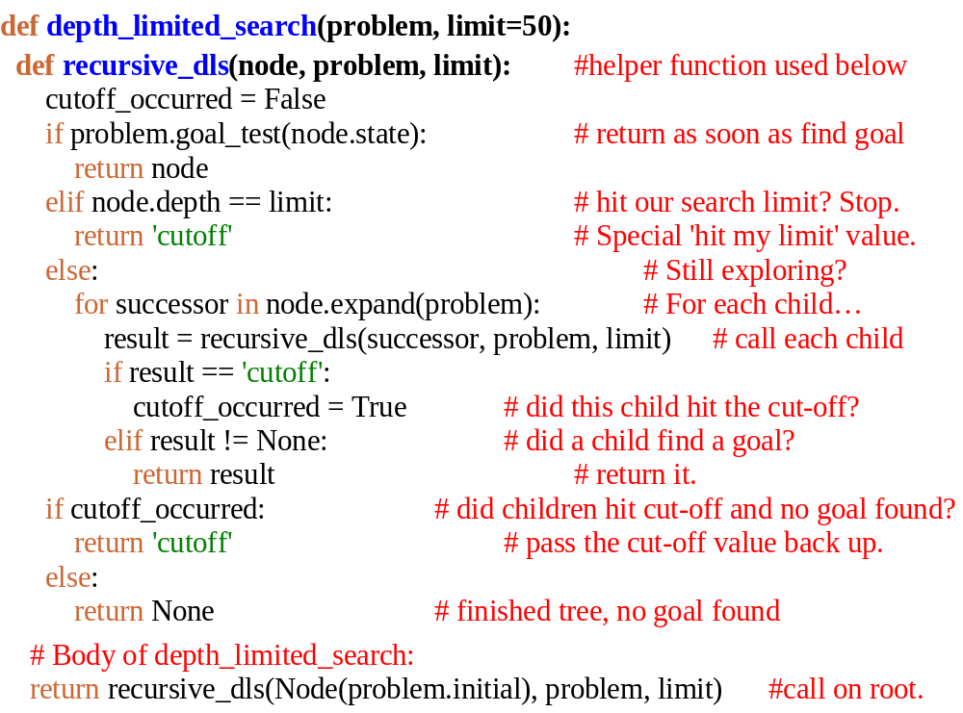
Depth Limited Searching
def depth_limited_search(problem, limit=50):
def recursive_dls(node, problem, limit): #helper function used below
cutoff_occurred = False
if problem.goal_test(node.state): # return as soon as find goal
return node
elif node.depth == limit: # hit our search limit? Stop.
return 'cutoff' # Special 'hit my limit' value.
else: # Still exploring?
for successor in node.expand(problem): # For each child…
result = recursive_dls(successor, problem, limit) # call each child
if result == 'cutoff':
cutoff_occurred = True # did this child hit the cut-off?
elif result != None: # did a child find a goal?
return result # return it.
if cutoff_occurred: # did children hit cut-off and no goal found?
return 'cutoff' # pass the cut-off value back up.
else:
return None # finished tree, no goal found
# Body of depth_limited_search:
return recursive_dls(Node(problem.initial), problem, limit) #call on root.

Slide 26
Depth Limited Searching
def depth_limited_search(problem, limit=50):
def recursive_dls(node, problem, limit): #helper function used below
cutoff_occurred = False
if problem.goal_test(node.state): # return as soon as find goal
return node
elif node.depth == limit: # hit our search limit? Stop.
return 'cutoff' # Special 'hit my limit' value.
else:
for successor in node.expand(problem): # Still exploring?
result = recursive_dls(successor, problem, limit) # call each child
if result == 'cutoff':
cutoff_occurred = True # did children hit the cut-off?
elif result != None: # did we get a goal passed back?
return result # return it.
if cutoff_occurred:
return 'cutoff' # pass the cut-off value back up.
else:
return None # ran out of tree to search, no goal
# Body of depth_limited_search:
return recursive_dls(Node(problem.initial), problem, limit) #call this on the root.

Slide 27
Iterative Deepening
def iterative_deepening_search(problem):
for depth in xrange(sys.maxint):
result = depth_limited_search(problem, depth)
if result is not 'cutoff':
return result
-----------------------------------------------------------------------------
  sys.maxint : A big integer.
  xrange() : A special range() function for
  dealing with large numbers.
  Gives you integers 0, 1, 2, ...

Slide 28

The Informed
Search Algorithms

Slide 29
g() vs. h() vs. f()
f() – Whatever function we pass to best first
search, sometimes we use the two
functions below in its definition.
g() – Cost of edges from the root to here.
So, this is: Problem.path_cost()
h() – heuristic guess of the future cost from here
to the goal. For A*, must also be ‘admissible.’

Slide 30
Best First Search: f() = ?
def best_first_graph_search(problem, f):
“Search the nodes with the lowest f scores first.”
return graph_search(problem, PriorityQueue(min, f))
But what does “Best” mean?

Slide 31
Best First Search: f() = ?
def best_first_graph_search(problem, f):
“Search the nodes with the lowest f scores first.”
return graph_search(problem, PriorityQueue(min, f))
If f() is set to the node depth, (every path costs 1)
then it's merely Breadth First Search.
If f() is set to g(), the path cost from root to here,
then this is Least Cost Search.
If f() is set to h(), heuristic guessed-distance-to-goal,
then it's Greedy Search.

Slide 32
A* Search: f() = g()+h()
As you can imagine, A* search also uses the code for Best–First Search.
It looks like everybody is using it!
In this case, A* sets f() = g() + h().
  g() – The path cost from start state to the current state.
  h() – Heuristic function guessing distance to goal.

Slide 33
An Implementation of A*
def build_f_for_a_star(problem):
“““THIS FUNCTION RETURNS A FUNCTION!
Returns function to calculate g()+h() for a specific problem.
Lambda expression creates a function to be returned.
The function created takes one argument: a node.
problem.path_cost is our g() and problem.h is our h().”””
return (lambda n: (problem.path_cost(n) + problem.h(n)))
To turn best-first into A*, pass it the function g()+h()…
best_first_graph_search(someProb, build_f_for_a_star(someProb))

Slide 34
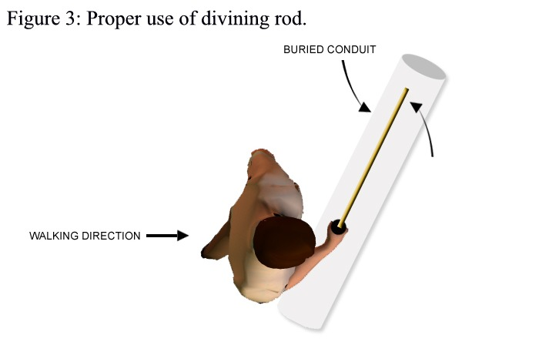
Some thoughts on heuristics…

Slide 35
Inventing a new heuristic
A good rule of thumb for inventing a new heuristic for a problem is to think about your problem as a set of limitations or restrictions on what you can do to get to your goal.
  Driving from town to town, you must use roads.
Then consider removing some restrictions to get to your goal sooner. This could be a heuristic.
  Imagine you didn’t need to stick to roads, and you could take the point-to-point distance to get there.
  “As the crow flies” heuristic used in map problems.

Slide 36
Why must heuristics underestimate?
An Intuitive Explanation:
  Reality vs. guessing.
  An overestimate “scares you away from the solution.”
    You’ll never try that path… In reality, it might be great!
  Better to get “lured in” by an underestimate, see for yourself that it’s really a bad path, and go elsewhere.
Needed or else our code won’t always find the best answer. Too high an estimate by a heuristic will scare the search away from the best path and it might first find the goal via a non–optimal path.

Slide 37
A final thought on heuristics…

Slide 38
A final thought on heuristics…
Why “heuristic” is a terrible, terrible word.

Slide 39
HEU vs. HUE
The fact that the word “heuristic” exists in the English language is the primary reason no one can remember how to spell my last name.
Heuristic
Huenerfauth

Slide 40
HEU vs. HUE
The fact that the word “heuristic” exists in the English language is the primary reason no one can remember how to spell my last name.
Heuristic
Huenerfauth

Slide 41
HEU vs. HUE
The fact that the word “heuristic” exists in the English language is the primary reason no one can remember how to spell my last name.
Heuristic
Huenerfauth
Guess of distance to goal.
Try to relax the problem a
little in order to get one.
Referred to by h().
Used in Greedy search.
A* requires h admissible.
Really hard to spell.

